Slide 1



Paper sharing:U-net series
Speaker :Ying Jie

Slide 2
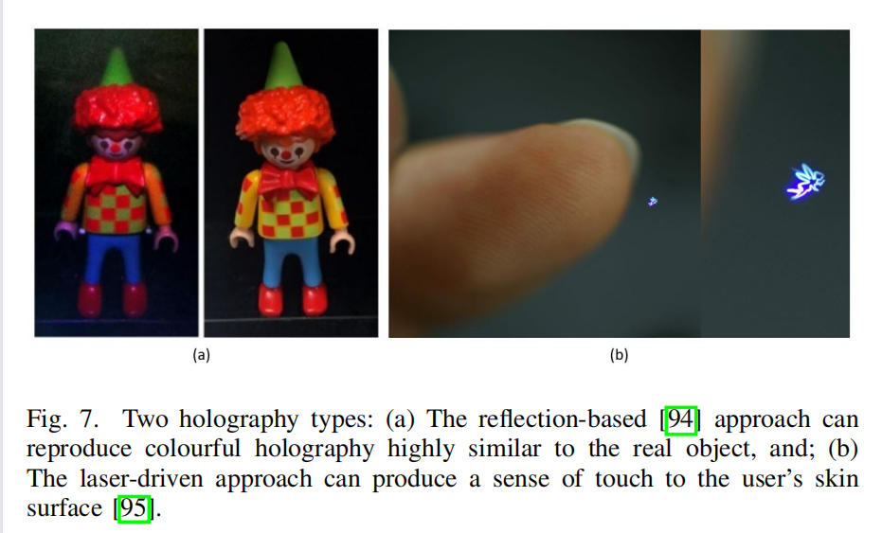
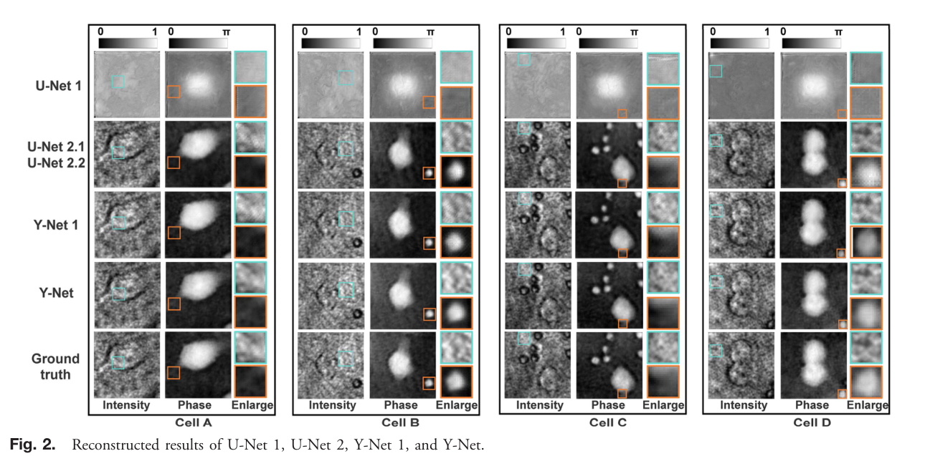

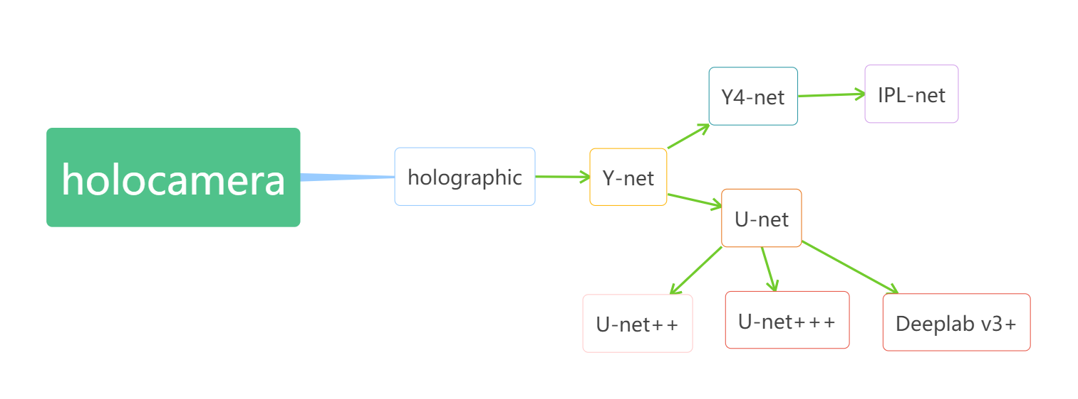
My process of selecting and reading papers in this week
two questions

Slide 3
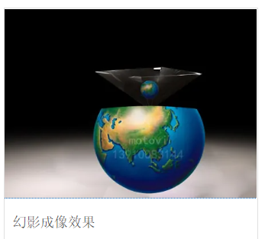
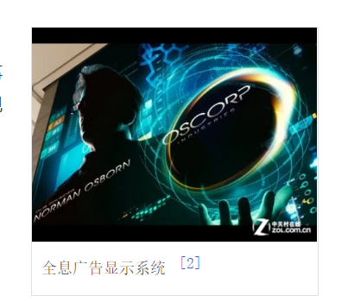
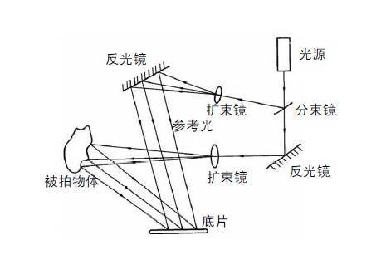
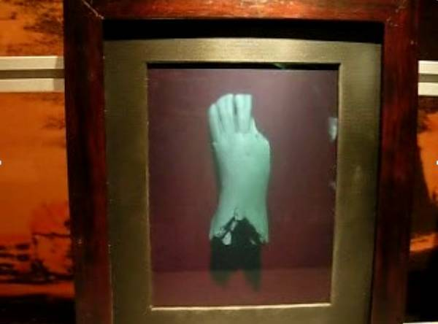
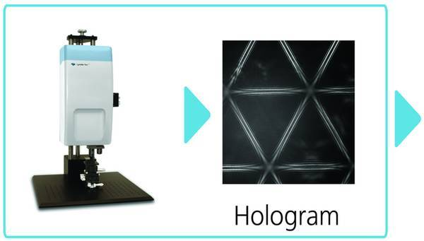
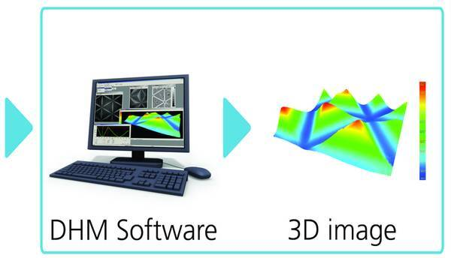
Difference between Optical holography & Digital holography
3D display technology
(spectra vision)
Optical holography
Digital holography

Slide 4
Background Knowledge 1
1. Convolution & Deconvolution
2. The elastic deformation
3. CNN/FCN & Image segmentation

Slide 5



CNN: What is a convolution?
valid
full
same

Slide 6
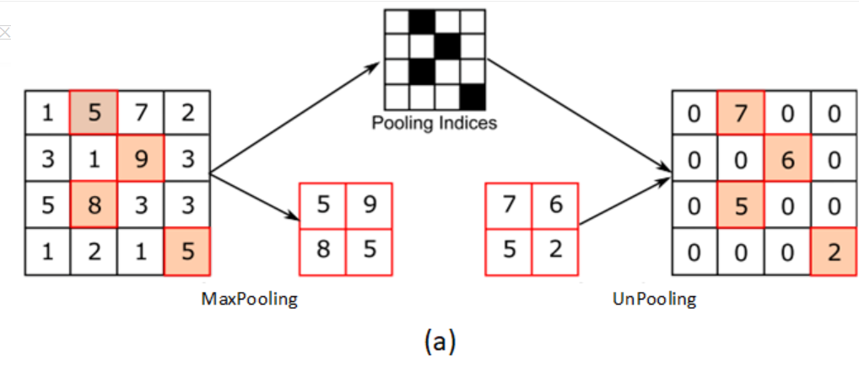
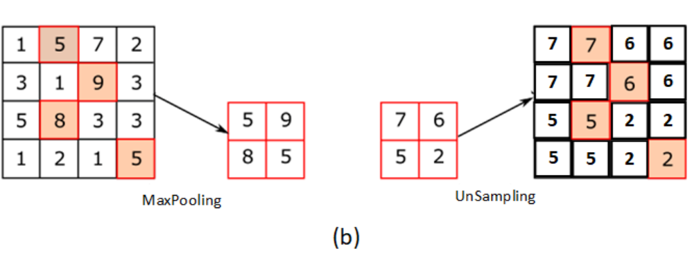
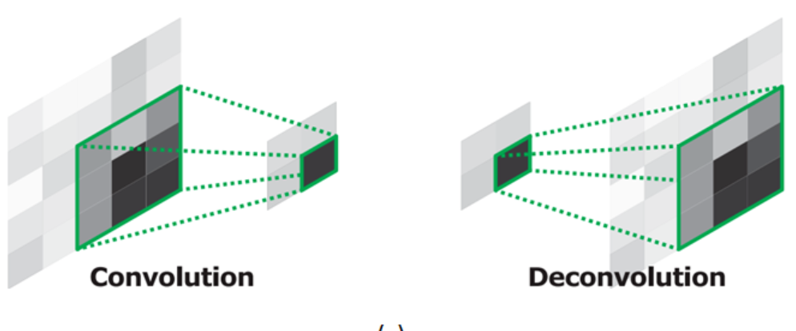
Convolution & Deconvolution
for convolution:
output = (input + 2 * p - k) / s + 1;
for deconvolution:
output = (input - 1) * s + k - 2 * p;
(input refers to “input dimension”，s refers to stride；k refers to kernel_size；p refers to pad，considered as 0.)

Slide 7
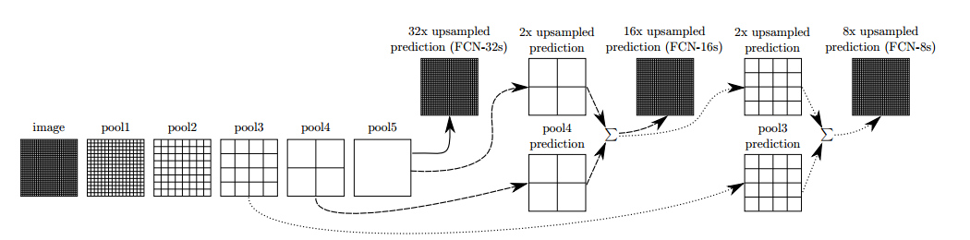
Convolution & Deconvolution

Slide 8
The elastic deformation（ICDAR 2003）
Target：To solve the problem of not having enough samples
Use：It is often used to transform character samples
Implementation steps：
（1）Firstly, generate two random numbers between -1 and 1 for each pixel (x,y) in the image.δx (x,y) and δy (x,y), which represent the moving distance of the pixel in the x direction and y direction respectively.
（2）Generate a Gaussian kernel k_NN with 0 as the mean and σ as the standard deviation, convolve with the previous random number, and apply the result to the original image.
（If σ is too small, the generated result is similar to random movement of each pixel of the image, while if σ is too large, the generated result is basically similar to the original image.）

Slide 9
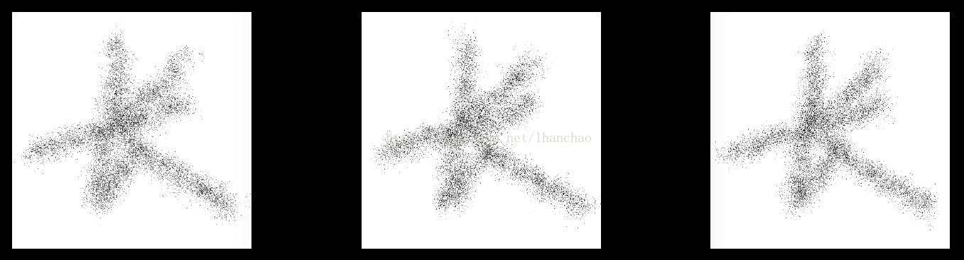
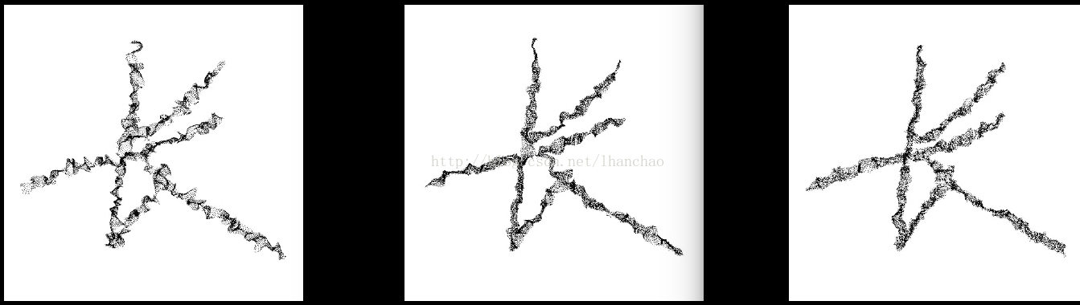
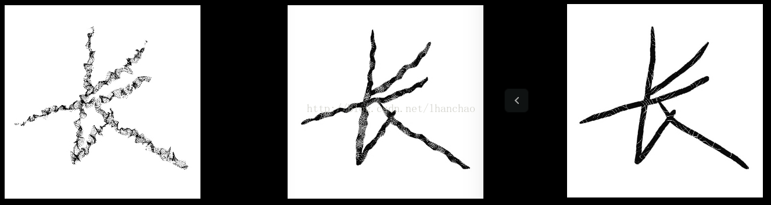
The elastic deformation（ICDAR 2003）
（1）while n = 5,σ=4,8,16：
（2）while n = 21,σ= 4,8,16：
（3）while n = 105,σ = 4,8,16：
The authors did not explain the influence of the size of N in Gaussian kernel K_NN on the image processing results. The original image is 573*573, and the resulting convolution results show that δx (x,y) and δy (x,y) are enlarged by 100 times respectively (because δx (x,y) and δy (x,y) are -1~1, so if they are not enlarged, no change can be seen).

Slide 10
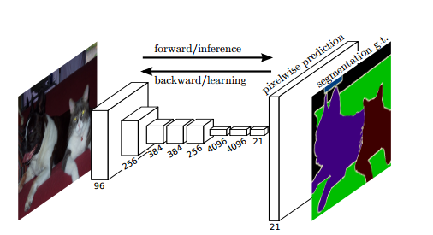
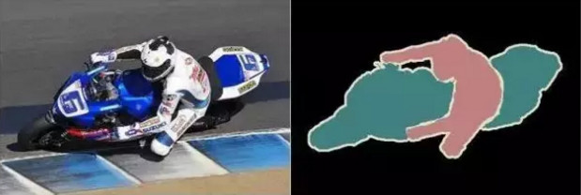
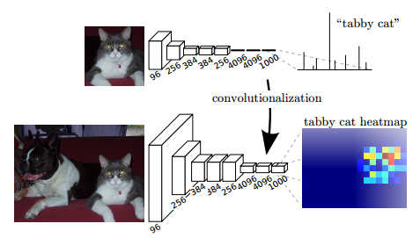
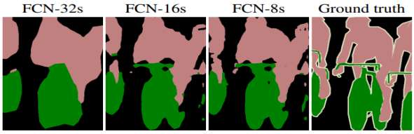
CNN/FCN &Image Segmentation
CNN/FCN

Slide 11
1. U-net :Convolutional Networks for Biomedical
Image Segmentation
# Paper Abstract：
1. Provenance：MICCAI 2015 (MIC+CAI)
2. Author：Olaf Ronneberger, Philipp Fischer& Thomas Brox
3. Cites：10k+ （According to incomplete statistics）
U-net
· Deep learning networks and training strategies are adopted to use annotated samples more effectively according to the way of data enhancement
· The U-NET shows extremely high performance when using the same network trained to project light microscope images

Slide 12
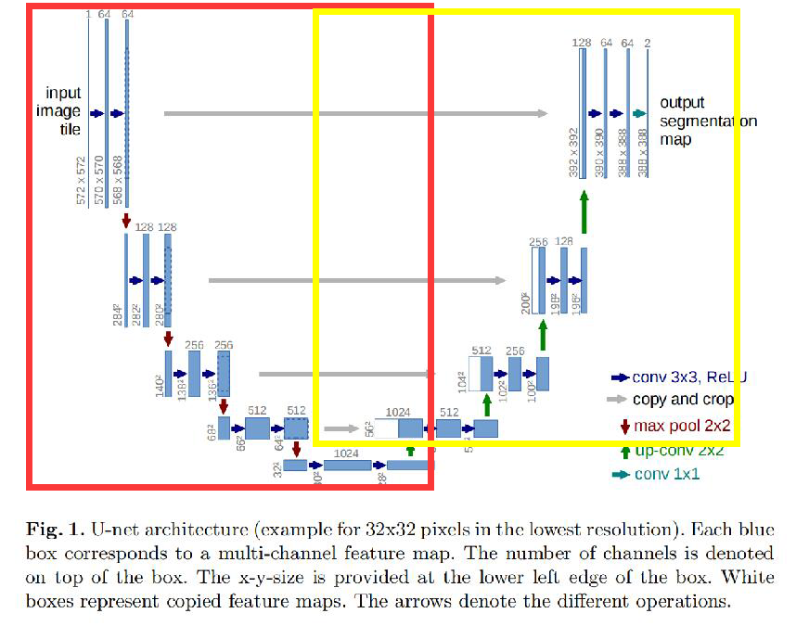
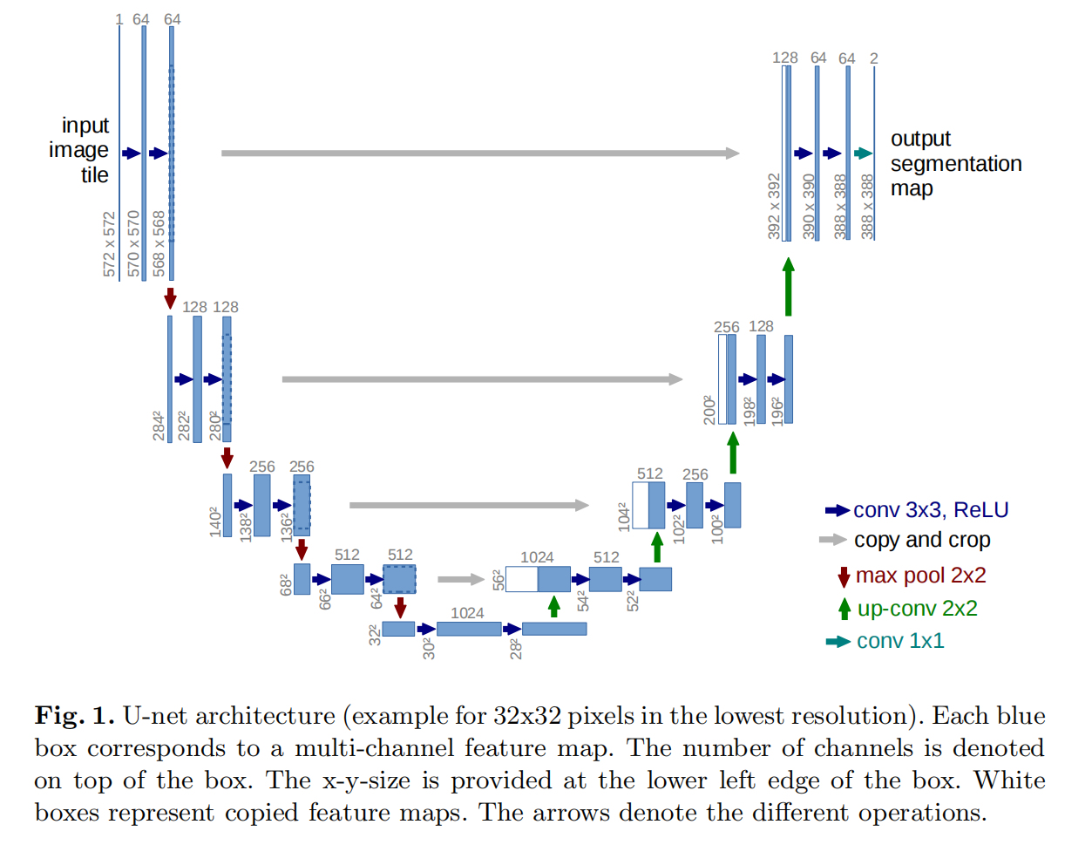
U-net conceptual graph
In the feature extraction part, there is a scale for every pooling layer, including 5 scales of the original image.
For the up-sampling part, every time the up-sampling is performed, the number of channels corresponding to the feature extraction part will be fused at the same scale, but the CROP should be selected before fusion. The fusion here is also splicing.
· RED represents feature extraction
·Yellow represents the upsampling part

Slide 13
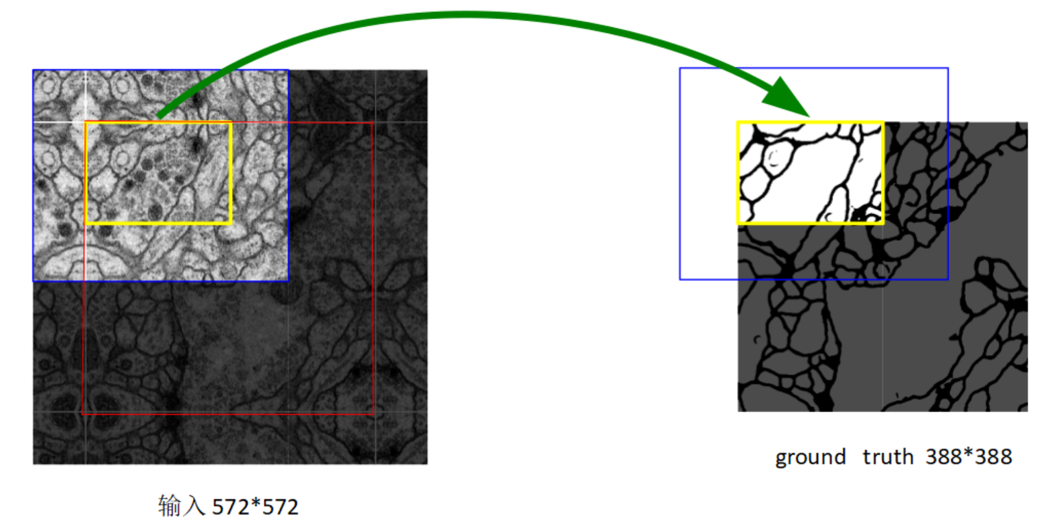
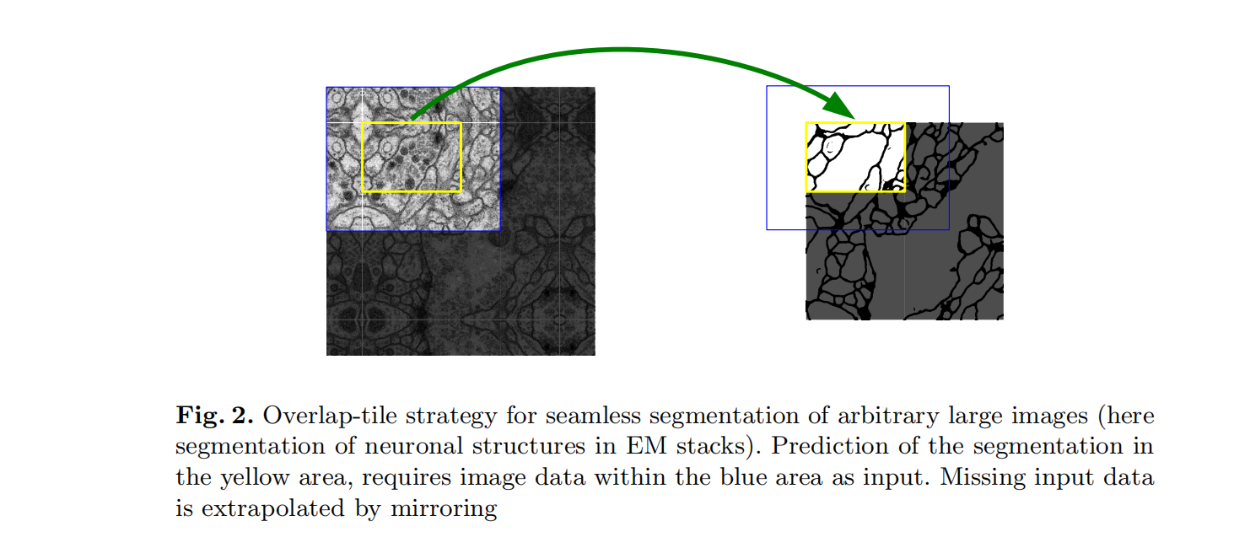
Examples & Strict requirements for U-net
The red box is the important segmentation area, and the edge of the yellow box indicates that the segmentation result is not affected by cutting into small batches

Slide 14
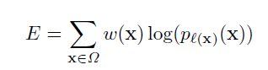
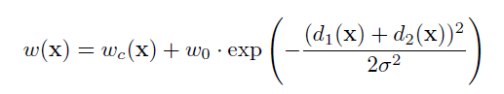
Training U-net & Formula
1. The last layer adopts cross entropy function and softmax function
Training method : Stochastic gradient descent
2. Weight chart calculation formula
first set w0 = 10, σ = 5

Slide 15
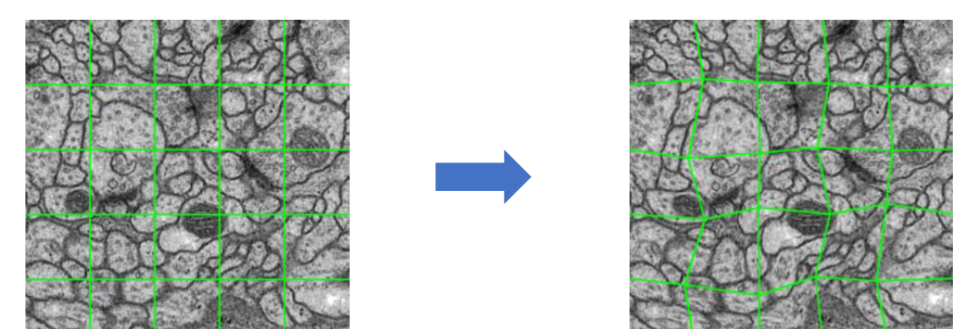
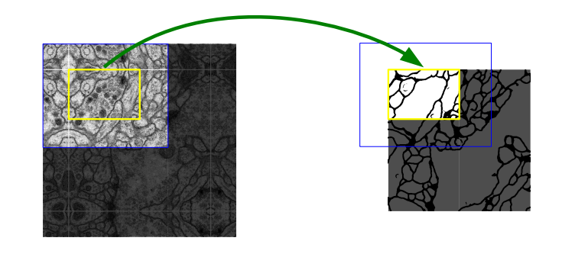
Improvement of U-net’s images
1. Using “elastic deformation”
2. Edge distortion
3. Before training, each piece is enlarged by mirror image to retain more edge information

Slide 16
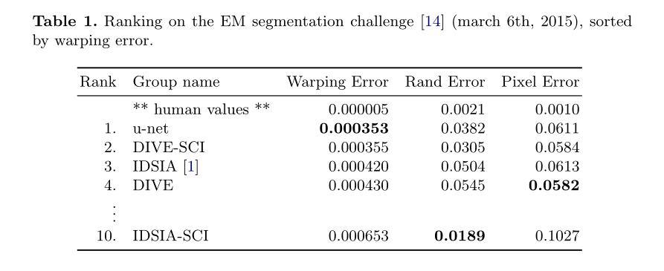
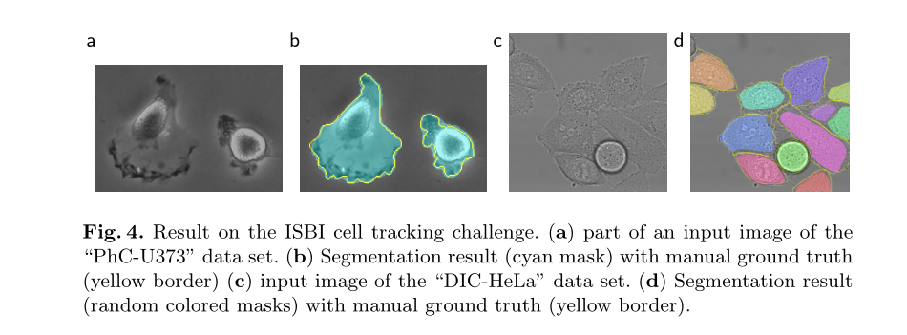
Outcome of U-net experiment
win the contset for it’s low warping error(扭曲误差)
ISBI tracking challenge——it’s excellent segmentation

Slide 17
U-net’s advantages & disadvantages
Advantages
1. The edge features are well preserved by the image edge processing
2. The structure of the network is simple and easy to improve
3. The network structure is shallow and information is not easily lost
4. Update of ”w“ is really imaginative & effective
Disadvantages
1. The effect of UNet may be unsatisfactory in many situations

Slide 18
2. Y -Net: a one-to-two deep learning framework
for digital holographic reconstruction
# Paper Abstract：
1. Provenance：Optics Letters 2019
2. Author：KAIQIANG WANG, JIAZHEN DOU, QIAN KEMAO, JIANGLEI DI,AND JIANLIN ZHAO
3. Cites：65+ （According to incomplete statistics）
Problem solved : It can solve end-to-end image processing tasks better than U-NET can solve situations that serve more purposes
Model Abstract : One to two deep learning model

Slide 19
Background Knowledge 2
1. What is a hologram——intensity and phase
2. Adam optimizer summarize

Slide 20
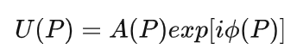
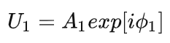
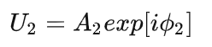
What is a hologram——intensity and phase
Definition of holography
A hologram is a picture of a subject recorded on a high resolution holographic film by a holographic camera with laser as the light source. With the same laser irradiation, can form before and after two virtual and real stereo scene.
Compared to traditional photographs, holograms contain information about the size, shape, brightness and contrast of the object being recorded.
Complex amplitude（复振幅）:
Complex amplitude expression of object light（物光的复振幅表达式）:
Complex amplitude expression of reference light（参考光的复振幅表达式）:

Slide 21
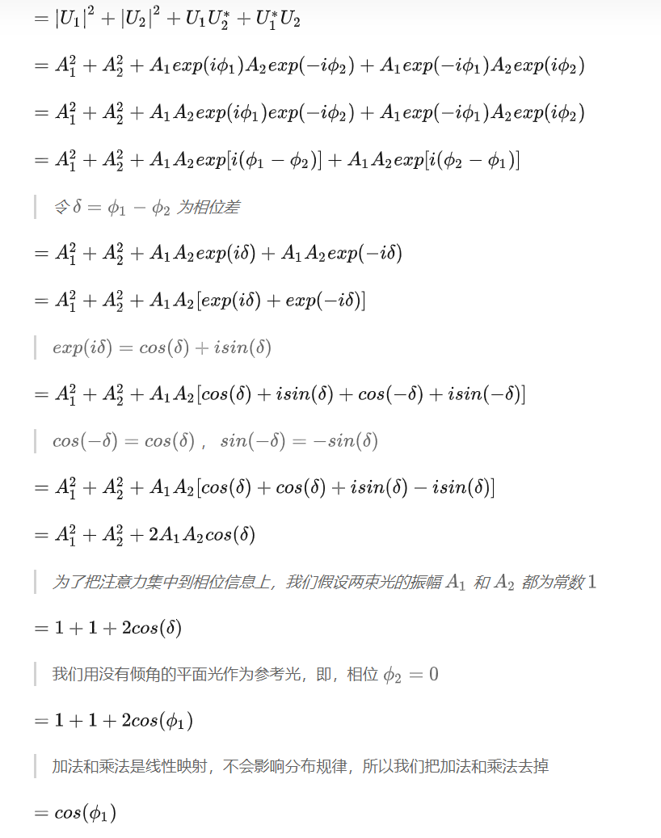
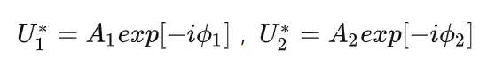
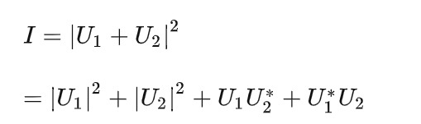
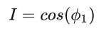
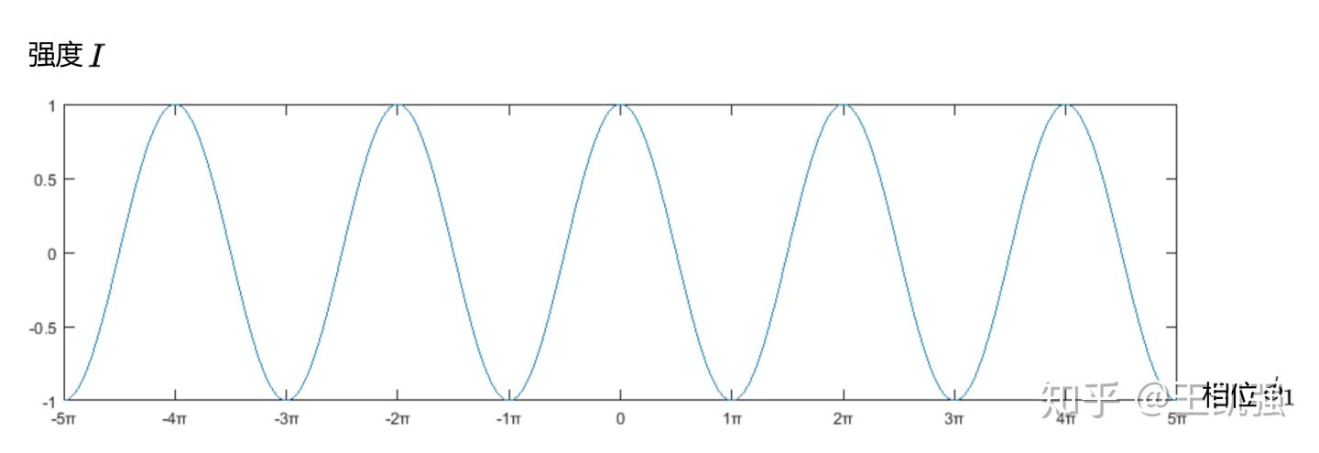
What is a hologram——intensity and phase
Conjugate(共轭) expression of object light and reference light:

Slide 22
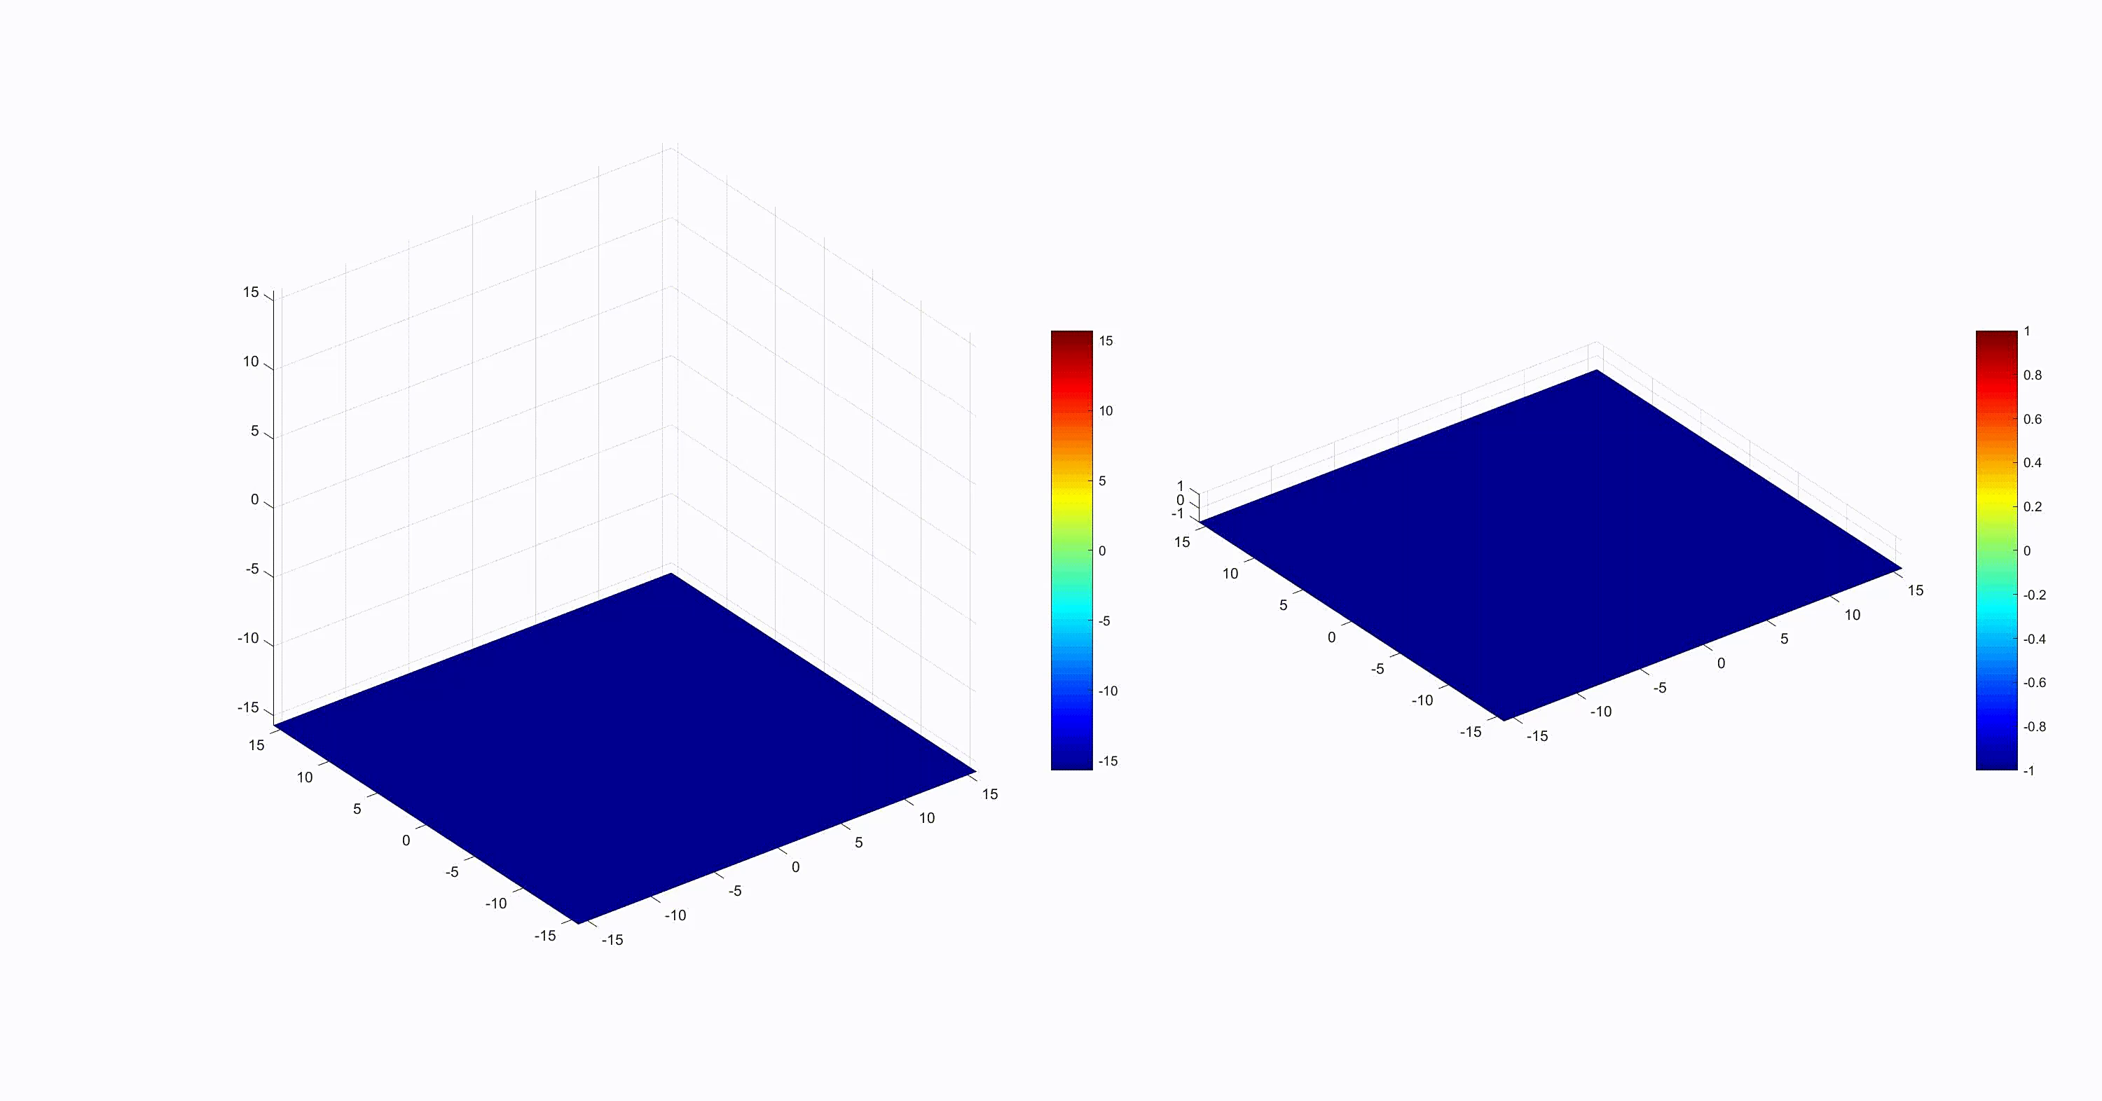
What is a hologram——intensity and phase

Slide 23
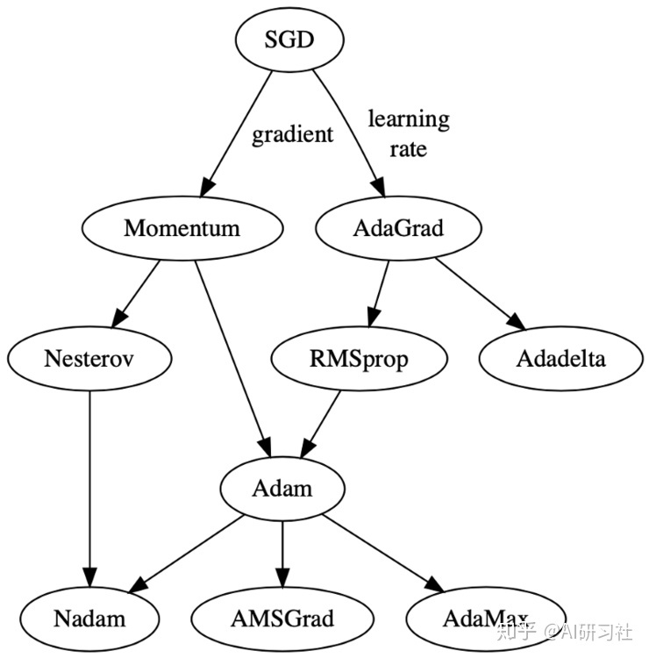
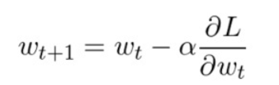
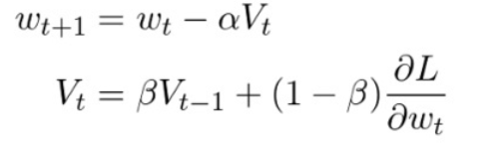
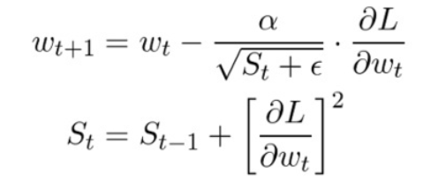
Adam optimizer summarize
1. Stochastic Gradient Descend
2. Momentum
β = 0.9,V=0
3. Adagrad(自适应)
α = 0.01
ε = 10⁻⁷

Slide 24
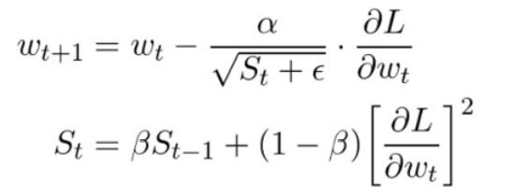
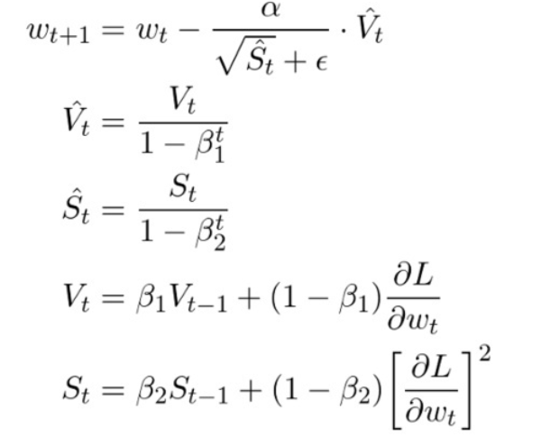
Adam optimizer summarize
4. RMSprop(均方根传递)
S = 0
α = 0.001
β = 0.9
ε = 10⁻⁶
α = 0.001
β₁ = 0.9
β₂ = 0.999
ε = 10⁻⁸
5. Adam(适应性矩估计)

Slide 25
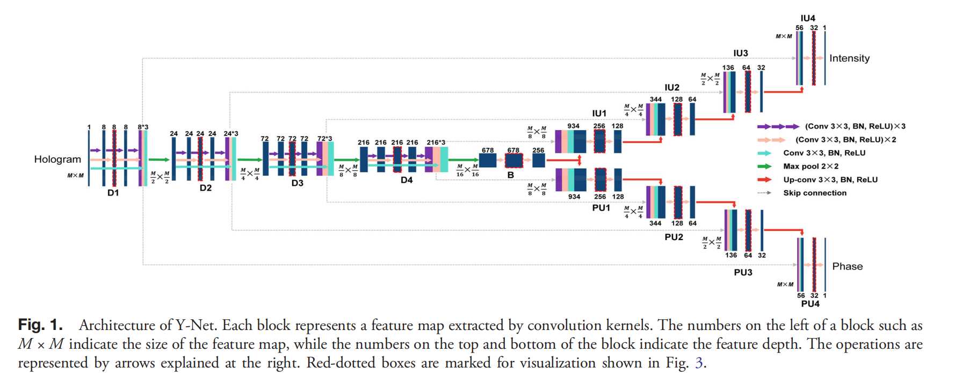
Y-net conceptual graph
BN+RELU

Slide 26
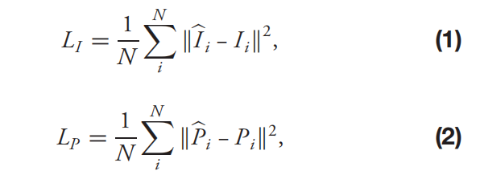
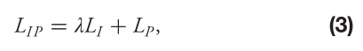
Training Y-net & Formula
Mean square error（MSE） is used in training
The Adam optimizer with a learning rate starting from 0.001 and halved after every 10 epochs and the mini-batch size of 64 are adopted to update the network’s parameter.
To avoid over-fitting of the neural network, the training stops when the network performance on the validation dataset begins to decline.
N：mini-batch size
where the weight λ of 0.01 gives a good performance
the phase is more highlighted than the intensity in training the network！

Slide 27
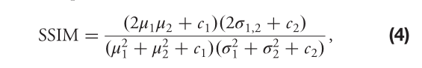
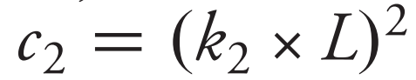

Training Y-net & Formula
To quantitatively evaluate the recovery accuracy of the networks, the following structural similarity (SSIM) index
c1 and c2 are regularization parameters with L = 255 (the range of pixel values), k1 = 0.01, and k2 = 0.03

Slide 28
Training Y-net & Formula
The dataset is recorded by a typical digital holographic microscope with a 50× objectivlens. The specimens are mouse phagocytes maintained in a humidified incubator at 37°C and 5% CO2 in Dulbecco’s modified eagle medium (DMEM) supplemented with 10% heat-inactivated fetal bovine serum and 1% penicillin-streptomycin mixture. After attaching to the bottom of a culture dish, 1664 holograms are recorded by the digital holographic microscope. Then the intensity and phase maps of these cells are reconstructed by the convolution method used as ground truth. All the data we have are partitioned into 80% for training, 10% for validation, and 10% for testing.

Slide 29



Outcome of Y-net experiment

Slide 30
Compare with U-net
1. Since the Y-Net saves a down-sampling path and a bridge path, it has 16,029,468 (16M) parameters, compared with 22,790,520 (23M) parameters in U-Net 2, leading to a reduction of 30%, which means that the Y-Net not only combines the functions of intensity and phase reconstruction, but also consumes less time in network training and holographic reconstruction, compared with using two typical U-Nets separately.
2. To summarize, in this Letter, we propose a unique one-to-two Y-Net specially designed for simultaneous reconstruction of intensity and phase information from a single digital hologram. This new method achieves excellent reconstruction results, with SSIM of over 0.96 for intensity and over 0.91 for phase, which defeats other network variants such as a typical U-Net with two output channels (U-Net 1), two typical U-Nets for intensity and phase reconstruction, respectively(U-Net 2), and a Y-Net without single or triple 3 × 3 convolutions (Y-Net 1).

Slide 31
3. Y4-Net: a deep learning solution to one-shot
dual-wavelength digital holographic reconstruction
# Paper Abstract：
1. Provenance：Optics Letters 2020
2. Author：KAIQIANG WANG, JIAZHEN DOU, QIAN KEMAO, JIANGLEI DI,AND JIANLIN ZHAO
3. Cites：23+ （According to incomplete statistics）
Idea :
In this paper, a deep learning solution (Y4-NET, four-output channel network) for one-time dual-wavelength digital holography is proposed to solve the spectral overlap problem.
Model Abstract : One to two deep learning model

Slide 32

Y4 - net conceptual graph
Problems:
1. It is proposed that the existing ways of generating digital hologram images are susceptible to environmental disturbance
2. The existing solution, the "DH method", is not easy to separate different wavelengths of light

Slide 33


Training Y4-net & Formula

Slide 34


Outcome of Y4-net experiment

Slide 35
Y4-net’s advantages & disadvantages
Advantages
1. The problem of segmentation after different wavelength superposition is solved
2. Compared to Y-Net and other holograms, the quality of the effect generated is much better
Disadvantages
1. The trained network is valid only in a small area around the parameters of the original optical Settingss

Slide 36

Other nets(Upgrated from U-net)
1. U-net++

Slide 37

Other nets(Upgrated from U-net)
1. U-net++

Slide 38

Other nets(Upgrated from U-net)
2. U-net+++(U-net 3+)

Slide 39

Other nets(Upgrated from U-net)
2. U-net+++(U-net 3+)

Slide 40

Other nets(Upgrated from U-net)
3. Deep lab - v3+

Slide 41

Other nets(Upgrated from U-net)
3. Deep lab - v3+

Slide 42

Other nets(Upgrated from U-net)
4. U2-net

Slide 43
Other nets(Upgrated from U-net)
4. U2-net

